Slide 1
Database Systems
  ORDB: Collections

Slide 2
Last Lecture
Object types
  Declaring
  Row objects/ column objects
  References
    Dereferencing (implicit join)
Constraints on object tables
Any questions?

Slide 3
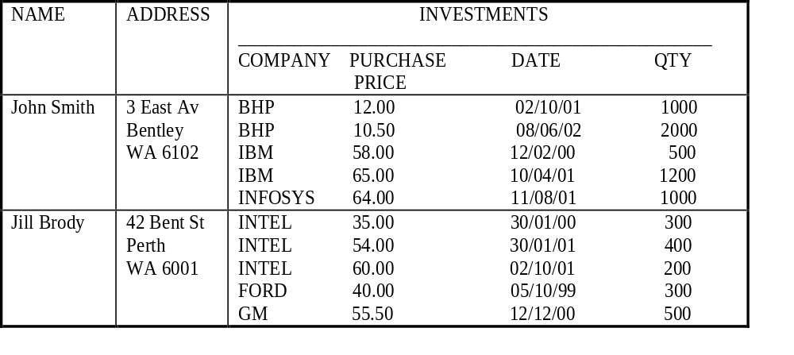
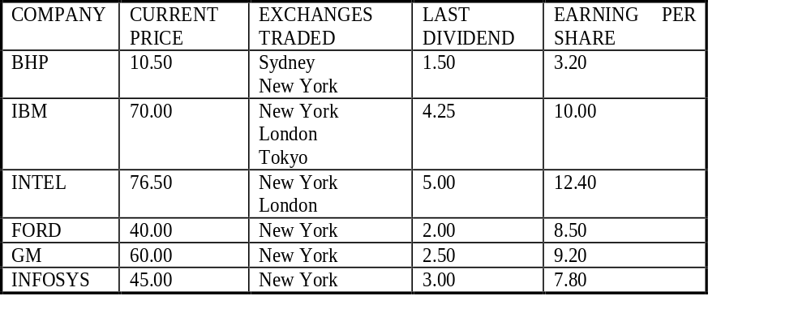

Slide 4
Collection Types
Useful for modelling one-to-many relationships.
  Example: An investor makes many share purchases.
Collection datatypes in Oracle:
  varrays
  nested tables.

Slide 5
VARRAYs
Arrays of variable size.
  Specify a maximum size when you declare the array type.
  Creating an array type does not allocate space.
    Since it is only a type definition.
Examples:
  CREATE TYPE price_arr AS VARRAY(10) OF NUMBER(12,2);
  The VARRAYs of type PRICES have no more than ten elements, each of data type NUMBER(12,2).

Slide 6
VARRAYs
A varray type can be used as:
  the data-type of a column of a relational table;
  an attribute data-type in an object type definition;
Example:
  Create type excharray as varray(5) of varchar(12)
  /
  Create type share_t as object(
    cname varchar(12),
    cprice number(6,2),
    exchanges excharray,
    dividend number(4,2),
    earnings number(6,2))
    /

Slide 7
Creating a VARRAY
To insert a collection use its type constructor method.
  The type constructor method has same name as the type.
  Its argument is a comma-separated list of collection elements.
Example:
  create table shares of share_t(
  cname primary key);
  insert into shares values(‘BHP’, 10.50,
  excharray( ‘Sydney’ ,’New York’), 1.50, 3.20);

Slide 8
VARRAY Example
  CREATE TYPE price_arr AS
  VARRAY(10) OF NUMBER(12,2)
  /
  CREATE TABLE pricelist (
  pno integer,
  prices price_arr);
  INSERT INTO pricelist
  VALUES(1, price_arr(2.50,3.75,4.25));

Slide 9
Retrieving from a VARRAY
  SELECT * FROM pricelist;
    PNO PRICES
    --------------------------------
    1 PRICE_ARR(2.5, 3.75, 4.25)
  SELECT pno, s.COLUMN_VALUE price
  FROM pricelist p, TABLE(p.prices) s;
    PNO PRICE
    --------------
    1 2.5
    1 3.75
    1 4.25

Slide 10
Nested Tables
Allow values of tuple components to be whole relations.
If T is a UDT, we can create a table type S:
CREATE TYPE S AS TABLE OF T ;
  Values of type S are relations with rowtype T.
  S can be the type of an attribute in another UDT or in a relation.
  See the example on next slide.

Slide 11
Example: Nested Table Type
CREATE TYPE BeerType AS OBJECT (
name CHAR(20),
kind CHAR(10),
colour CHAR(10))
/
CREATE TYPE BeerTableType AS
TABLE OF BeerType
/

Slide 12
Example - Continued
CREATE TABLE Manfs (
name CHAR(30),
addr CHAR(50),
beers beerTableType)
NESTED TABLE beers STORE AS beer_table;
BeerTableType used in Manfs relation to store the set of beers by each manufacturer in one tuple.

Slide 13
Storing Nested Tables
Oracle doesn’t really store each nested table as a separate relation
  it just makes it look that way.
  tuples of all the nested tables for one attribute A are stored in one relation R.
Declare a storage of nested tuples in CREATE TABLE by:
NESTED TABLE A STORE AS R
In previous example,
  NESTED TABLE beers STORE AS beer_table;

Slide 14
Querying a Nested Table
We can retrieve the value of a nested table like any other value.
But these values have two type constructors:
  For the table.
  For the type of tuples in the table.
Find the beers by Anheuser-Busch:
SELECT beers FROM Manfs
WHERE name = ’Anheuser-Busch’;
Produces one value like:
BeerTableType(
BeerType(’Bud’, ’lager’, ’yellow’),
Beertype(’Lite’, ’malt’, ’pale’),
…)

Slide 15
Querying Within a Nested Table
A nested table can be converted to an ordinary relation by applying TABLE(…).
This relation can be used in FROM clauses like any other relation.
Find the ales made by Anheuser-Busch:
  SELECT b.name
  FROM TABLE( SELECT beers
  FROM Manfs
  WHERE name = ’Anheuser-Busch’) b
  WHERE b.kind = ’ale’;

Slide 16
Nested Table Example 2
  -- ‘/’ after each type definition omitted to save space
  CREATE TYPE proj_t AS OBJECT (
  projno NUMBER,
  projname VARCHAR (15));
  CREATE TYPE proj_list AS TABLE OF proj_t;
  CREATE TYPE employee_t AS OBJECT (
  eno number,
  projects proj_list);
  CREATE TABLE employees of employee_t (eno primary key)
  NESTED TABLE projects STORE AS employees_proj_table;

Slide 17
Inserting and Retrieving
Insert a row into employees table:
    INSERT INTO employees VALUES(1000, proj_list(
    proj_t(101, 'Avionics'),
    proj_t(102, 'Cruise control')
    ));
To retrieve the projects of eno 1000:
  SELECT *
  FROM TABLE(SELECT t.projects FROM employees t
  WHERE t.eno = 1000);
  PROJNO PROJNAME
  --------------------
  101 Avionics
  102 Cruise control

Slide 18
Collection Unnesting
Unnest or flatten the collection attribute of a row
  by joining each row of the nested table with the row that contains the nested table.
  Example:
  SELECT e.eno, p.*
  FROM employees e, TABLE (e.projects) p;
  ENO PROJNO PROJNAME
  ---- ---------- ---------------
  1000 101 Avionics
  1000 102 Cruise control
  2000 100 Autopilot

Slide 19
DML on Collections:
Use a TABLE expression to identify the nested table values.
  INSERT INTO TABLE(SELECT e.projects
  FROM employees e
  WHERE e.eno = 1000)
  VALUES (103, 'Project Neptune');
  UPDATE TABLE(SELECT e.projects
  FROM …) p
  SET p.projname = 'Project Pluto'
  WHERE p.projno = 103;
  DELETE TABLE(SELECT e.projects
  FROM …) p
  WHERE p.projno = 103;

Slide 20
DML on Nested Tuples
To drop a particular nested table, set the nested table column in the parent row to NULL.
  UPDATE employees e
  SET e.projects = NULL
  WHERE e.eno = 1000;
To add back a nested table row:
  UPDATE employees e
  SET e.projects = proj_list(proj_t(103, 'Project Pluto'))
  WHERE e.eno=1000;

Slide 21
DML on Nested Tuples
There is a difference between a NULL value and an empty constructor. To add back a nested table row, we could have done it in two steps as follows:
UPDATE employees e
SET e.projects = proj_list() // Creates a nested table w/o any rows
WHERE e.eno=1000;
INSERT INTO TABLE
(SELECT e.projects FROM employees e WHERE e,eno = 1000)
VALUES (proj_t(102, ‘Project Pluto’));

Slide 22
Multilevel Collection Types
Collection types whose elements are themselves another collection type.
Possible multilevel collection types are:
  Nested table of nested table type
  Nested table of varray type
  Varray of nested table type
  Varray of varray type
  Nested table or varray of a user-defined type that has an attribute that is a nested table or varray type

Slide 23
Multilevel Collection Types Example
Models a system of stars in which each star has a collection of the planets revolving around it, and each planet has a collection of its satellites.
  CREATE TYPE sat_t AS OBJECT ( name VARCHAR2(20), orbit NUMBER);
  /
  CREATE TYPE sat_ntt AS TABLE OF sat_t
  /
  CREATE TYPE planet_t AS OBJECT ( name VARCHAR2(20), mass NUMBER, satellites sat_ntt)
  /

Slide 24
Multilevel Collection Types Example… (contd.)
  CREATE TYPE planet_ntt AS TABLE OF planet_t;
  /
CREATE TYPE star_t AS OBJECT ( name VARCHAR2(20), age NUMBER, planets planet_ntt)
/
CREATE TABLE stars_tab of start_t ( name PRIMARY KEY)
NESTED TABLE planets STORE AS planets_nttab
(NESTED TABLE satellites STORE AS satellites_nttab );
Separate nested table clauses are provided for the outer planets nested table and for the inner satellites one.

Slide 25
Multilevel Collection Types Example… (contd.)
  Inserting a new star called ‘Sun’…
  INSERT INTO stars VALUES('Sun',23,
    nt_pl_t( planet_t( 'Neptune',10,
    nt_sat_t(satellite_t('Proteus',67),
    satellite_t('Triton',82))),
    planet_t('Jupiter',189,
    nt_sat_t(satellite_t('Callisto',97),
    satellite_t('Ganymede', 22)) ) ));

Slide 26
Multilevel Collection Types Example… (contd.)
  Inserting a planet called ‘Saturn’ to the star ‘Sun’…
  INSERT INTO TABLE( SELECT planets FROM stars WHERE name = 'Sun')
    VALUES ('Saturn', 56,
    nt_sat_t(
    satellite_t('Rhea', 83)
    )
    );

Slide 27
Multilevel Collection Types Example… (contd.)
  Inserting a satellite called ‘Miranda’ to planet ‘Uranus’ of the star ‘Sun’…
  INSERT INTO TABLE(
  SELECT p.satellites
  FROM TABLE( SELECT s.planets
  FROM stars s
  WHERE s.name = 'Sun') p
  WHERE p.name = 'Uranus')
  VALUES ('Miranda', 31);

Slide 28
Summary
Collection Types
  VARRAYs
  Nested Tables
DDL, DML and SELECTs on Collection Types
Multilevel collection types

